Slide 1
Machine Learning
Machine Learning Introduction to Machine Learning by Kumar Anurupam is licensed under a Creative Commons Attribution-4.0 International License.
Machine Learning – Types and Issues
CS 3104 Fall 2019
Lecture Slides by Kumar Anurupam

Slide 2
Learning Outcome
After the completion of today’s session you will be able to:
Explain the types of Machine Learning.
Illustrate the issues in Machine Learning.

Slide 3
Types of Machine Learning
Machine Learning systems can be broadly divided according to the following ways:
Systems which requires human supervision.
Online VS Batch learning(Incremental learning or not from the incoming data)
Instance VS Model based learning.

Slide 4
1. Machine Learning systems based on human supervision
Human Supervision
Supervised
Unsupervised
Semisupervised
Reinforcement

Slide 5
Supervised Learning
The main goal in supervised learning is to learn a model from labeled training data that allows us to make predictions about unseen or future data. [1]
Here, the term supervised refers to a set of samples where the desired output signals (labels) are already known.
In supervised learning, the training data you feed to the algorithm includes the desired solutions, called labels. [2]

Slide 6
Supervised Learning contd…
Example:
-> Spam filter – Classification problem
-> Car price prediction on the basis of features – Prediction problem
Supervised learning algorithms to be discussed later:
-> Linear Regression
-> Logistic Regression
-> Support Vector Machines (SVMs)
-> Neural networks

Slide 7
UnSupervised Learning
In unsupervised learning, however, we are dealing with unlabeled data or data of unknown structure. Using unsupervised learning techniques, we are able to explore the structure of our data to extract meaningful information without the guidance of a known outcome variable or reward function. [3]
In unsupervised learning, as you might guess, the training data is unlabeled. The system tries to learn without a teacher. [4]

Slide 8
UnSupervised Learning contd…
Example:
-> Forming groups of people having similar interests - clustering
Supervised learning algorithms to be discussed later:
Clustering
k-Means
Hierarchical Cluster Analysis (HCA)
Visualization and dimensionality reduction
Principal Component Analysis (PCA)

Slide 9
Semi-Supervised Learning
Some algorithms can deal with partially labeled training data, usually a lot of unlabeled data and a little bit of labeled data. This is called semisupervised learning.[5]
Example: Google photos – Suppose you have uploaded many photos, It can recognize same people in multiple photos. We just need to tell it who the persons are.

Slide 10
Reinforcement Learning
The reinforcement learning is slightly different than the previous strategies.
The learning system, called an agent in this context, can observe the environment, select and perform actions, and get rewards in return (or penalties in the form of negative rewards).
It must then learn by itself what is the best strategy, called a policy, to get the most reward over time. A policy defines what action the agent should choose when it is in a given situation.[6]
Example: A robot making decision on the basis of experience.

Slide 11
2. Machine Learning systems based on incremental learning
Incremental Learning
Batch
Online

Slide 12
Batch Learning
In batch learning, the system is incapable of learning incrementally: it must be trained using all the available data.
This will generally take a lot of time and computing resources, so it is typically done offline.
First the system is trained, and then it is launched into production and runs without learning anymore; it just applies what it has learned. This is called offline learning.[7]
Example:

Slide 13
Online Learning
In online learning, you train the system incrementally by feeding it data instances sequentially, either individually or by small groups called mini-batches.
Each learning step is fast and cheap, so the system can learn about new data on the fly, as it arrives.[8]
Example: System which predicts the stock price.

Slide 14
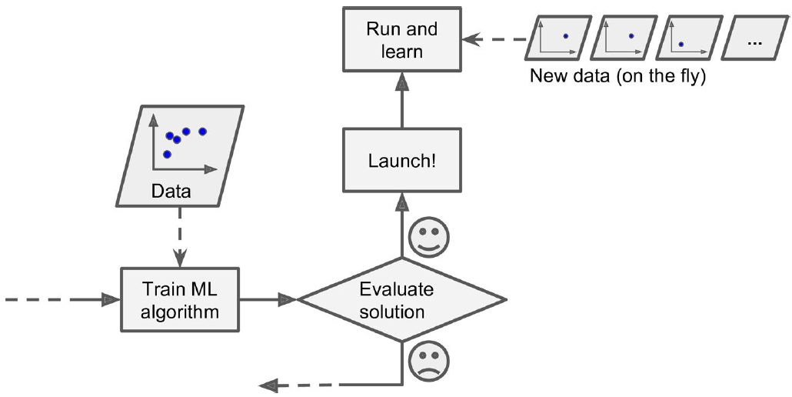
Online Learning[9]

Slide 15
3. Machine Learning systems based on generalization
Generalization
Instance based
Model based

Slide 16
Instance Based Learning
In machine learning, instance-based learning (sometimes called memory-based learning[) is a family of learning algorithms that, instead of performing explicit generalization, compares new problem instances with instances seen in training, which have been stored in memory.[10]
Example: Flagging emails as spam on the basis of similarity to known spam mails.

Slide 17
Model Based Learning
Another way to generalize from a set of examples is to build a model of these examples, then use that model to make predictions. This is called model-based learning.[11]

Slide 18
Challenges in Machine Learning
?????????

Slide 19
Issues in Machine Learning
Insufficient quantity of Training Data.
Non-representative Training Data.(Data from all domains)
Poor quality data.
Irrelevant features.
Overfitting the Training Data.(Avoid overgeneralizing due to data quality or quantity)
Underfitting the Training Data.(Simple models)

Slide 20
Summary
Machine Learning can be categorized on the basis of three categories: i.e. on the basis of human interaction, incremental learning and generalization.
The drawbacks of machine learning is dependent on the quantity, quality, features, overfitting and underfitting of the Data.

Slide 21
References
[1,3] Sabastian Raschka. “Python Machine Learning”, PACKT Publishing
[2,4,5,6,7,8,9,11] Aurelien Geron, “Hands-On Machine Learning with Scikit-Learn & TensorFlow” O Reilly
[10] https://en.wikipedia.org/wiki/Instance-based_learning

Slide 22
Thanks

